Slide 1
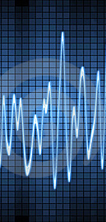
Chapter 3: Describing Sound Waves

Slide 2
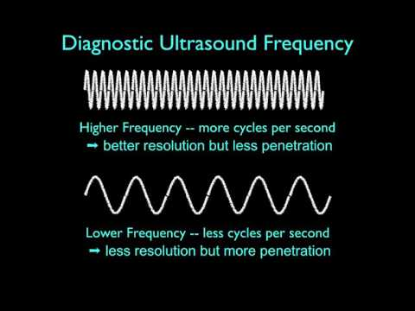
Ultrasound Physics: Understanding the Basics of Image Generation

Slide 3
Describing Sound Waves with…
Acoustic Parameters describe features of a sound wave. The values of seven parameters are required to completely characterize a continuous sound wave.
Period
Frequency
Amplitude
Power
Intensity
Wavelength
Propagation speed
Notes:
We will be learning how to describe sound waves using 7 acoustic parameters. Edelman groups certain parameters together based on their relationships, it will be helpful to you to learn them this way.

Slide 4
You must know…
the values and units for each parameter
understand how the parameters are related to one another
Whether we can change the parameter?
distance
time
power
directly or indirectly
Can we make a change to the sound source?
Notes:
Keep in mind while you are studying

Slide 5

The sound source
The ultrasound system and transducer.
The quantity or level of some parameters are established by the ultrasound system.
Some of these parameters can be changed by using controls on the machine, others cannot.
Notes:
By sound source, we are referring to the ultrasound machine and transducer. Some parameters are set by the system and cannot be changed by the sonographer, others can be changed by the sonographer.

Slide 6
The medium
The medium is the material through which the sound waves travel.
In the case of sonography, the medium is soft tissue.
Some parameters are determined by the medium
Notes:
When we refer to the medium in ultrasound physics, unless otherwise specified, we are speaking about soft tissue.

Slide 7
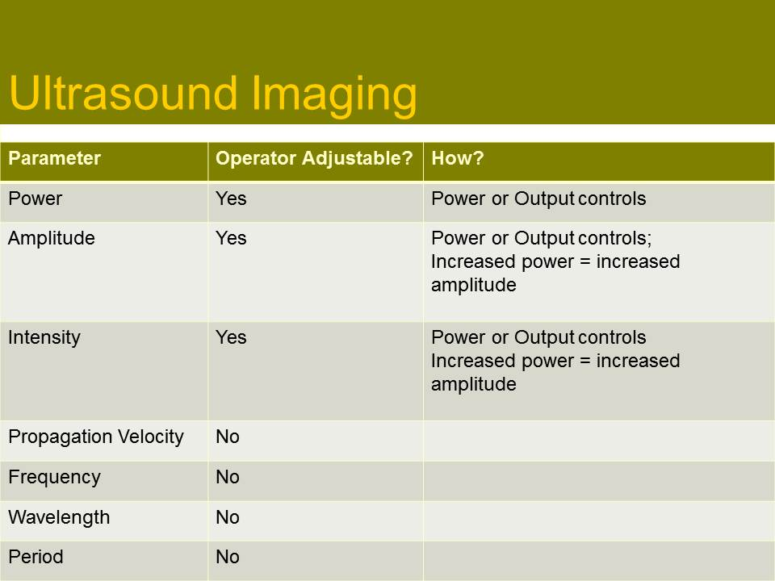
Sound source vs. Medium
If you know whether a parameter is determined by
the sound source or the medium,
you can understand how the parameter relates to the principles of ultrasound physics.
Notes:
Table shows if the operator can adjust the machine settings to impact the parameter

Slide 8
Parameters that describe sound waves Just as you may describe yourself as 5 feet, 5 inches tall, 150 lbs etc. you must also describe similar features of a sound wave.
Period
Frequency
Amplitude
Power
Intensity
Speed
Wavelength
Notes:
Draw sound wave and define different parts

Slide 9
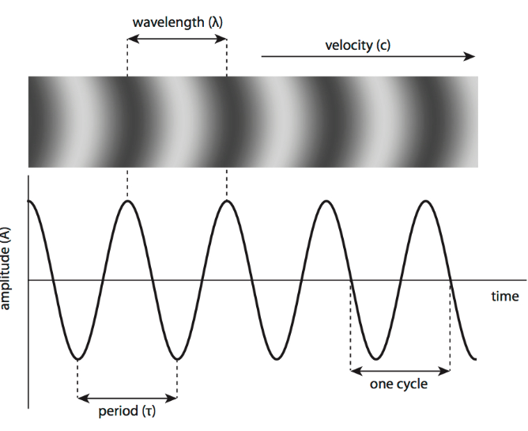
Visible parameters of the sound wave
Notes:
period, wavelength, frequency, amplitude Note: Period is denoted by a “T” and frequency is “f”

Slide 10
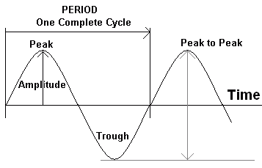
Period the time it takes to complete one cycle
Measured in units of time
Typical values for ultrasound 0.1-.05 microseconds
Determined by the sound source
Cannot be changed by the sonographer
Example: the cycle of the earth circling the sun is 365 days
Notes:
Remember from chapter 2 about peaks and troughs, a cycle is a peak and a trough

Slide 11
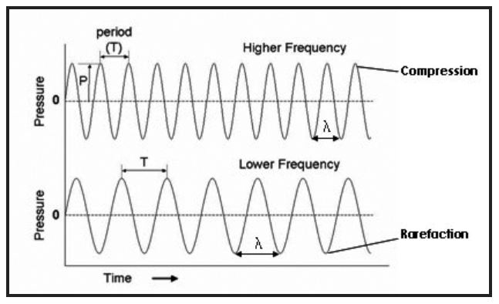
Which wave below has a longer period for each cycle?

Slide 12
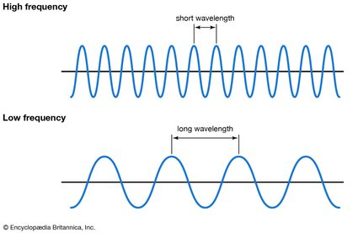
Frequency The number of events that occur in a set duration of time
in ultrasound, frequency is the number of cycles that occur in one second
Measured in hertz (cycles/second)
Determined by the sound source
Cannot be changed by the sonographer
Frequency affects penetration and image quality (more to come…)
Example: what is the frequency of your birthday?

Slide 13
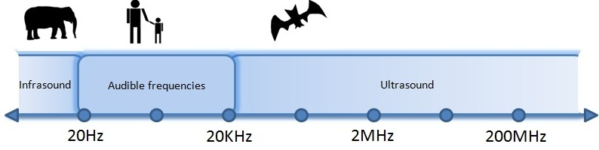
Frequency
The frequency of sound determines whether it is ultrasound, audible sound or infrasound
Ultrasound-frequency exceeds 20,000 Hz or 20 KHz
Audible sound is between 20 Hz and 20,000 Hz
Infrasound is less than 20 Hz and is not audible
Typical Ultrasound Values 2 MHz to 10Mhz

Slide 14
What is the frequency of each strip if the time is 1 sec?
Notes:
10 Hz
6 Hz

Slide 15
What is the frequency of each strip if the time is 2 sec?
Notes:
10Hz in 2 seconds = 5 Hz in 1 second
6 Hz in 2 seconds = 3 Hz in 1 second

Slide 16
What is the frequency of each strip if the time is 0.5 sec?
Notes:
10 Hz in 0.5 seconds = 20 Hz in one second
6 Hz multiply by 2 to make 12 cycles per one second

Slide 17
The relationship between Frequency and Period
Period and frequency are inversely related to each other
As frequency increases, period decreases proportionally.
As frequency decreases, period increases proportionally.
If period does not change, frequency does not change
More specifically, period and frequency are reciprocals
Notes:
Referenced

Slide 18
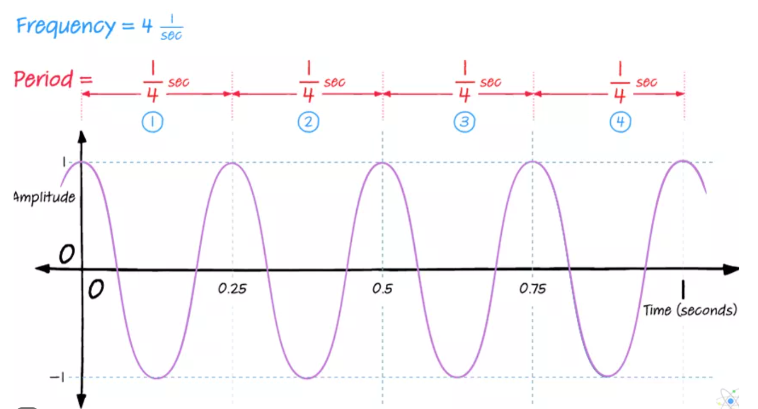
Frequency and Period are reciprocals
When two reciprocals are multiplied, they equal one
If the period (of a cycle) is 1/4 of a second,
that means there are 4 cycles in 1 second 1/4 x 4 =1

Slide 19
Remember Reciprocals?
What is the reciprocal of ½?
What is the reciprocal of 0.5?
What is the reciprocal of 2?
What is the reciprocal of 3?
What is the reciprocal of 0.25?

Slide 20
Check up?
Since frequency and period are reciprocals what happens to each parameter in these situations?
If frequency is doubled, period is ____.
If period is doubled, frequency is ____.
If period is tripled, frequency is ____.
If frequency is quartered, period is ____.

Slide 21
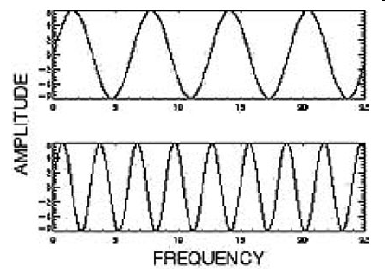
Putting it together:
Waves with longer periods have fewer waves per second.
Waves with shorter periods can be completed more quickly than those with longer periods so there will be more waves completed in each second.

Slide 22
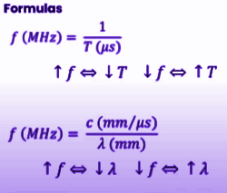
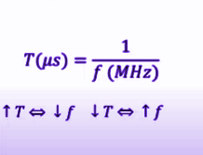
Frequency Period Formulas
Frequency x Period = 1
Notes:
Frequency is a number –
Period is time

Slide 23
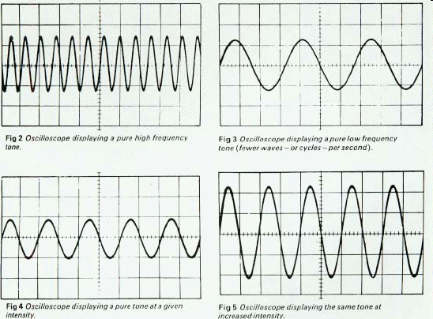
Which frequency is highest? (each take place in 1second)
A B
C D

Slide 24
Which frequency is lowest? (each take place in 1 second)
A B
C D

Slide 25
The “Bigness” Parameters
Tell us how big or how strong a wave is
Amplitude
Power
Intensity
Period
Frequency
Amplitude
Power
Intensity
Wavelength
Propagation speed

Slide 26
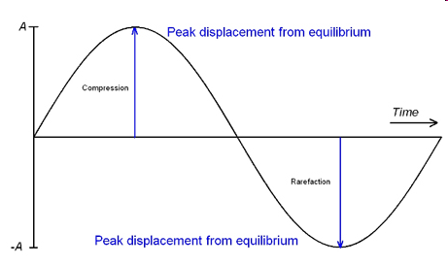
The “Bigness” Parameters: Amplitude
Amplitude – the difference between the average value and the maximum or minimum value of an acoustic variable
The “bigness” or height of a wave
Max value
Min value

Slide 27
Amplitude
Units are those of the acoustic variables
pressure – Pascals (Pa)
density – kg/cm³,
particle motion – ft, in, cm, mm
Also expressed in decibels (dB)
Typical values: 1MPa to 3 MPa (MegaPascals)
Determined by sound source
CAN be changed by the sonographer
Amplitude decreases as sound propagates through the body

Slide 28
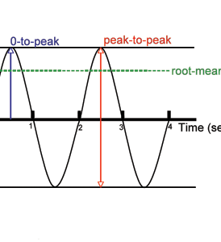
Peak-to-peak Amplitude
the difference between the minimum amplitude and the maximum amplitude
Notes:
Note that amplitude below the baseline is termed “minimum value”

Slide 29
The “Bigness” Parameters – Power
Power-the rate of energy transfer
Units are watts (W)
Typical values: 0.004 – 0.09 watts (4-90milliwatts)
Determined by the sound source
CAN be changed by the sonographer
Power decreases as sound propagates through the body…that is why it may need amplification…
Notes:
Watt/What is power ☺

Slide 30
Relationship of Power & Amplitude
Power is proportional to the amplitude of the wave squared
Power ∝ amplitude² P ∝ A²
Knowing this relationship, we can determine the change in power when given an amplitude.
Keep in mind that this is a relationship – not an equation
Reference in terms of increase or decrease by a factor of…?

Slide 31
Example
A sonographer increases the amplitude of a wave by a factor of 3. How has the power changed?
Remember the relationship:
Power ∝ amplitude²
Simply plug in the change in amplitude.
In this case it was increased by a factor of 3.
Power ∝ 3² SO Power would increase by a factor of 9!

Slide 32
Example
The sonographer decreases the amplitude by ½. What is the change in power?
Remember the relationship:
Power ∝ amplitude²
Simply plug in the change in amplitude.
Power = ½ ²
½ x ½ = ¼
Power is ¼ of what it was.

Slide 33
Example
The sonographer decreases the amplitude by 1/5. What is the change in power?

Slide 34
The “Bigness” Parameters - Intensity
Intensity - the concentration of energy in a sound beam
Describes the bigness of a wave
Relates to how the power in a beam is distributed in space.
Intensity depends on the amount of power in a beam and the area of which the power is applied.

Slide 35

Intensity concentration of energy in a sound beam
Intensity(watts/cm²)
Watts = power
cm² = beam area
Intensity = power (watts)
^{beam area (cm2)}
Determined by sound source
Can be changed by the sonographer (since power can be changed so can intensity)
Typical ultrasound values- 0.001-100watts/cm²

Slide 36
How is intensity related to power?
Intensity is directly proportional to power
So…if power is doubled, intensity is doubled
If power is quartered, intensity is quartered
If power proportional to intensity, what do we know about the relationship between intensity and amplitude?

Slide 37
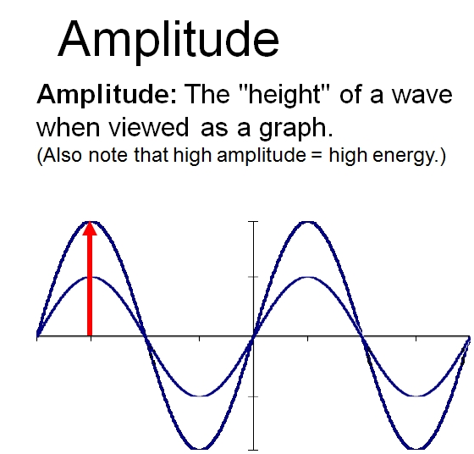
The reasoning behind it:
If power ∝ amplitude²
And…
power ∝ intensity (power and intensity are related in the same way)
It must mean that…
Intensity ∝ amplitude² (intensity has the same relationship to amplitude as power has to amplitude)
Notes:
It takes a lot of energy (power) and intensity to raise the amplitude…that is why the power and intensity are more than the amplitude

Slide 38
Other Intensity related math
Often you will be asked how intensity changes when another variable changes.
Example: Power is doubled and beam area remains unchanged. How will intensity change?

Slide 39
To solve:
Power is doubled and beam area remains unchanged. How will intensity change?
First use the equation for intensity:
Intensity = power (watts)
^{beam area (cm2)}
Next plug in the changes to the equation. (doubled =2, unchanged = 1, halved=1/2)
Intensity=2/1
In this case, intensity = 2 so intensity will be doubled
Notes:
Also…intensity and power are proportional, so if power is doubled, intensity is doubled (not figuring in beam area because it didn’t change)

Slide 40
Let's try another:
The power of a wave is doubled. If intensity remains the same, what must happen to beam area?
Intensity = power (watts)
^{beam area (cm2)}
In this case intensity =1, power =2 and beam area is unknown…
1=2/beam area
Beam area x 1 =2
Beam area = 2, so the beam area is doubled!

Slide 41
Continuing with acoustic parameters
Period
Frequency
Amplitude
Power
Intensity
Propagation speed
Wavelength

Slide 42
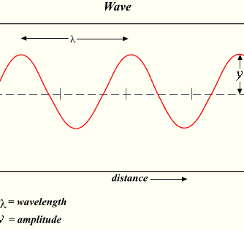
Wavelength The length or distance of a single complete cycle.
Units: any unit of length (mm)
Typical ultrasound values-0.1-0.8 mm (in soft tissue)
Determined by sound source and medium through which it travels
Cannot be changed by the sonographer
Wavelength is the ONLY parameter determined by the source and medium

Slide 43
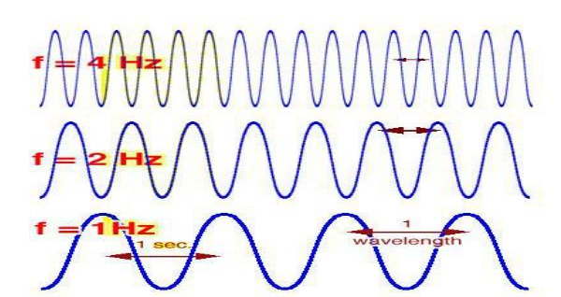
The relationship between wavelength and frequency (and period)
Wavelength and frequency are inversely related.
As wavelength increases, frequency decreases.
As wavelength decreases, frequency increases.
Higher frequency = shorter wavelength
Lower frequency = longer wavelength

Slide 44
The difference between wavelength and period
period and wavelength look the same on the diagram, but…
period is a measure of time (how much time to complete a cycle)
wavelength is a measure of distance (how far does the wave travel)

Slide 45
The wavelength equation:
_{λ =} propagation speed mm/μs _{λ = C}
frequency (MHz) F
λ is the symbol for wavelength, remember it because it looks like a wave!)
When using the wavelength equation, we must make sure our units match the units in the equation.
Wavelength should be in mm
Propagation speed should be in mm/μs
Frequency should be in MHz
If you are given a value that is not in this format you must convert!
Ex: if frequency is in Hertz you have to convert to megahertz!

Slide 46
wavelength and frequency
What is the wavelength of a sound wave with a frequency of 1 MHz in soft tissue?
Recall that :
_{λ =} propagation speed mm/μs _{λ = C}
frequency (MHz) F

Slide 47
Working the equation…
Propagation speed in soft tissue in mm/μs is 1.54 mm/μs
λ = 1.54 mm/ μs ÷ 1 MHz
1.54 / 1 = 1.54
λ = 1.54 mm

Slide 48
Wavelength problem
What is the wavelength of a sound wave with a frequency of 2 MHz in soft tissue?

Slide 49
Working the equation…
λ = 1.54 mm/μs ÷ 2 MHz
1.54 / 2 = 0.77
λ = 0.77 mm

Slide 50
Important!
In order to use 1.54 mm/μs as your speed of sound you must be informed that the medium is soft tissue!!
If you are not provided with a speed of sound, and it is not indicated that your medium is soft tissue, you do not have enough information to solve the problem.
If you are provided with a speed of sound, and frequency, simply ‘plug’ it into the equation.

Slide 51
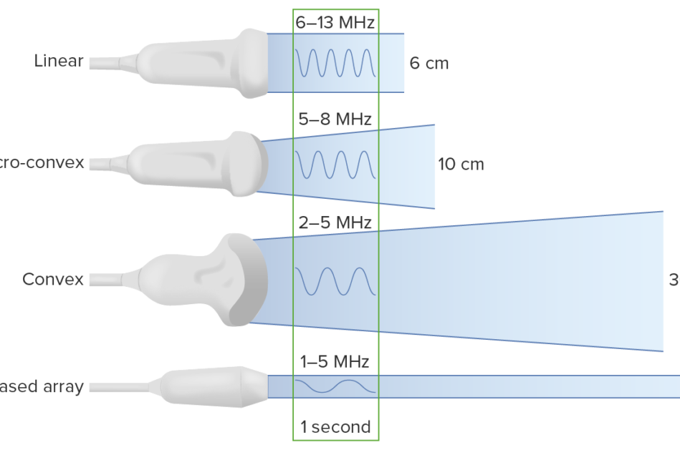
Why do we care about wavelength?
Wavelength is important in image quality.
Shorter wavelength sound produces higher quality images with greater detail.
This is why high frequency transducers provide better resolution because high frequency is associated with shorter wavelength.

Slide 52
Last Parameter: Propagation Speed
The rate that sound travels through a medium
The distance that sound travels in 1 second
Units: meters per second or mm/μs
Determined by medium only
Not adjustable
All sound will travel through any given medium at the same speed regardless of frequency or any other parameter value.

Slide 53
Equation #1 Propagation Speed
Example: A sound wave travels 10 cm in 2 seconds. What is the propagation speed in this medium?
Divide the distance by the time
10cm/2sec = 5 cm/sec
(the units carry over!)

Slide 54
Equation #2 Propagation Speed
Propagation Speed = frequency x wavelength
Why does this work?
What is interesting about this equation?
it is the same equation that is used to calculate wavelength! It is just arranged in a different way.
_{λ =} propagation speed mm/μs _{λ = C}
frequency (MHz) F
Notes:
Propagation speed is distance/time (mm/us) Frequency is time (MHz/us) and wavelength is distance (mm)

Slide 55
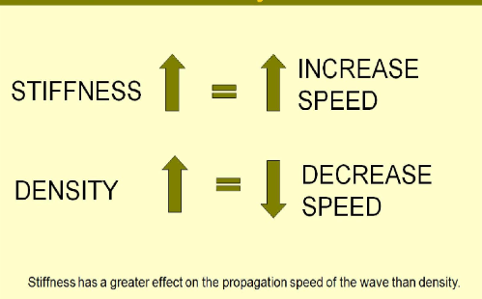
Characteristics of Medium and effects on Speed
Speed of sound is related to stiffness and density of a medium
Stiffness
Density
a medium’s ability to be moved/squished/change shape
Stiffness and Speed-directly related
Stiffness has more of an impact on speed than density
Bulk modulus is the same as stiffness
Compressibility is opposite of stiffness
related to a medium’s weight; how closely packed the molecules in that medium are
Density and Speed-inversely related
Notes:
Sound waves move through the medium by causing the particles to vibrate…if the particles are smooshy and move out of the way, the wave cannot go fast. When particles are more fixed, the wave can keep going. If particles are packed together tightly (dense) there isn’t much room to vibrate thus the wave cannot propagate quickly.
Think of walking to the beach…when you’re on the smooth boardwalk, you can go fast because its stiff and uniform…if part of the boardwalk is a suspension bridge, you have to slow down because the bridge moves…then when you get to the sand, you must move even more slowly because the sand is very squishy…and dense.

Slide 56
Propagation Speed in Tissue
Gas has the slowest speed of sound,
liquid is in the middle,
solids have the fastest speed of sound.
General rule: gas<liquid<solid
Hint: think about the stiffness or resistance to pressure of these media!
Tissue Type | Speed (m/s)
Lung | 500
Fat | 1,450
Soft Tissue | 1,540
Blood | 1,560
Muscle | 1,600
Bone | 3,500
Soft tissue can also be reported as 1.54 km/s or 1.54 mm/μs
1540 m/s is approximately 1 mile/second
Notes:
Know this table – be able to order the media by speed

